Slide 1

ECE 1001 : BASIC ELECTRONICS
2
Department of Electronics and Communication Engineering, MIT, Manipal

Slide 2
Part – I : Analog Electronics
CHAPTER-1: DIODES AND APPLICATONS
Reference:
Robert L. Boylestad, Louis Nashelsky, Electronic Devices & Circuit Theory, 11th Edition, PHI, 2012
1

Slide 3
Module – 1 : Diodes
Learning outcomes
At the end of this module, students will be able to:
Explain the operation of PN junction diode under different biasing condition.
Draw the I-V characteristic of diode and differentiate between ideal and practical diodes
Explain the concept of static and dynamic resistance of the diode.
Explain various breakdown phenomenon observed in diodes.
Describe the working of Zener diode and its I-V characteristic.
Explain the operation of diode as capacitor.

Slide 4
Review
Basic of Semiconductors
Doping in Semiconductors
2
Department of Electronics and Communication Engineering, MIT, Manipal

Slide 5
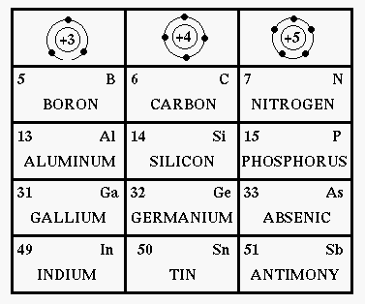
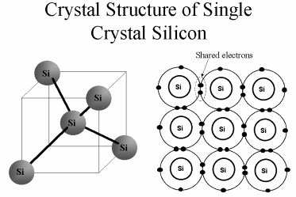
Semiconductors
Common semiconducting materials
Crystal structure of silicon
http://fourier.eng.hmc.edu/e84/lectures/ch4/node1.html
http://www.austincc.edu/HongXiao/overview/basic-semi/sld007.htm
Notes:
A semiconductor is a material which has electrical conductivity between that of a conductor such as copper and that of an insulator such as glass. Semiconductors are the foundation of modern electronics, including transistors, solar cells, light-emitting diodes (LEDs), quantum dots and digital and analog integrated circuits.
Mostly used semiconductor material is silicon. It consists of silicon in which the crystal lattice of the entire solid is continuous, unbroken (with no grain boundaries) to its edges. Silicon atomic core is surrounded by four valence electrons.

Slide 6
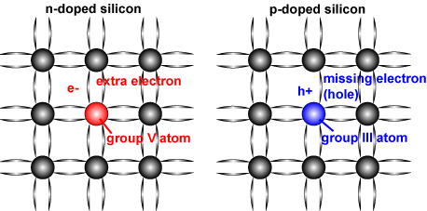
Doping in Semiconductors
Schematic of a silicon crystal lattice doped with impurities to produce n-type and p-type semiconductor material.
[http://www.pveducation.org/pvcdrom/pn-junction/dopingl].
Notes:
N-type semiconductor:
When a small amount of pentavalent donor atoms (e.g., phosphorus (P) and Arsenic (As)) is added, a silicon atom in the lattice may be replaced by a donor atom with four of its valence electrons forming the covalent bounds and one extra free electron. This is an N-type semiconductor.
P-type semiconductor:
When a small amount of trivalent acceptor atoms (e.g., boron (B) and aluminum (Al)) is added, a silicon atom in the lattice may be replaced by an acceptor atom with only three valence electrons forming three covalent bounds and a hole in the lattice. This is a P-type semiconductor.

Slide 7
Self test
1.Why silicon is preferred over germanium for semiconductor devices?
2.List different elemental and compound semiconductors.

Slide 8
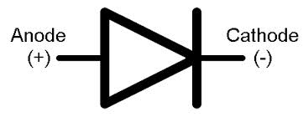
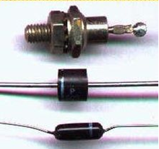
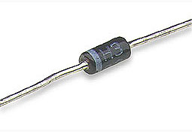
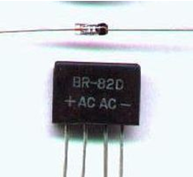
P-N Junction Diode
Anode
P
N
Cathode
Common practical diodes available in market
Notes:
P-N Junction diode: is a 2-terminal, 2-layer, single-junction semiconductor device made out of a single block of silicon or germanium, with one side doped with acceptor (p-type) impurity and the other side with donor (n-type) impurity. Numerous applications are like Switch, Rectifier, Regulator, Voltage multiplier, Clipping, Clamping, etc.
Construction:
The two terminals are called Anode and Cathode
1.At the instant the two materials are “joined”, electrons and holes near the junction cross over and combine with each other
2.Holes cross from P-side to N-side
3.Free electrons cross from N-side to P-side
4.At P-side of junction, negative ions are formed
5.At N-side of junction, positive ions are formed

Slide 9
P-N Junction Diode- conti…
Used in numerous applications
Switch,
Rectifier,
Regulator,
Voltage multiplier,
Clipping,
Clamping, etc.

Slide 10
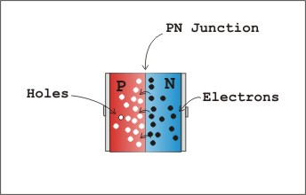
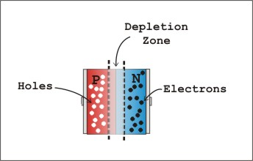
P-N Junction Diode under biasing
P-N junction (a) in contact (b) formation of depletion region
[http://www.imagesco.com/articles/photovoltaic/photovoltaic-pg3.html].
Notes:
Notes:
A PN junction have
- A P-type and N-type region
- Depletion region - region having no free carriers
Further movement of electrons and holes across the junction stops due to formation of depletion region
- Depletion region acts as barrier opposing further diffusion of charge carriers. So diffusion stops within no time
- Current through the diode under no-bias condition is zero Bias.

Slide 11
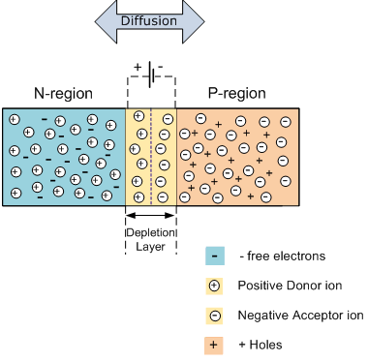
P-N Junction Diode under biasing condition
Unbias condition
Diode under zero bias conditions
Notes:
In the absence of an applied bias voltage, the net flow of charge in any one direction for a semiconductor diode is zero. This occurs because any minority carriers (holes) in the n-type material that find themselves within the depletion region will pass directly into the p-type material. The same happens with due to the electrons in the depletion region that will pass to the n-type material. The result is a depletion region empty of charge carriers, with high impedance, so no net current passes through the diode. This results in development of built-in potential ranging from 0.3-0.7 eV depending upon the type semiconducting material used.

Slide 12
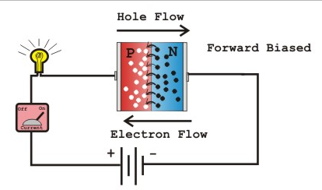
Forward bias
Positive of battery connected to p-type (anode)
Negative of battery connected to n-type (cathode)
Diode under forward biasing conditions
Notes:
Forward biasing:
When forward biasing is applied
-Electrons in n-type are forced to recombine with positive ions near the boundary, similarly holes in p-type are forced to recombine with negative ions
-Depletion region width reduces
-An electron in n-region “sees” a reduced barrier at the junction and strong attraction for positive potential
-As forward bias is increased, depletion region narrows down and finally disappears – leads to exponential rise in current
- Forward current is measured in milli amperes

Slide 13
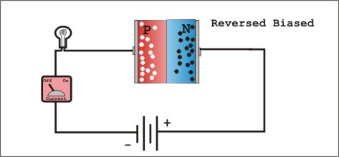
Reverse bias
Positive of battery connected to n-type material (cathode)
Negative of battery connected to p-type material (anode)
Diode under reverse biasing conditions
Notes:
Reverse biasing:
When reverse bias is applied
-Free electrons in n-region are drawn towards positive of battery, Holes in p-region are drawn towards negative of battery
-Depletion region widens, barrier increases for the flow of majority carriers
-Majority charge carrier flow reduces to zero
-Minority charge carriers generated thermally can cross the junction – results in a current called “reverse saturation current”.

Slide 14
Self test
1. The arrow direction in the diode symbol indicates
a. Direction of electron flow.
b. Direction of hole flow (Direction of conventional current)
c. Opposite to the direction of hole flow
d. None of the above
2. When the diode is forward biased, it is equivalent to
a. An off switch b. An On switch
c. A high resistance d. None of the above
.

Slide 15
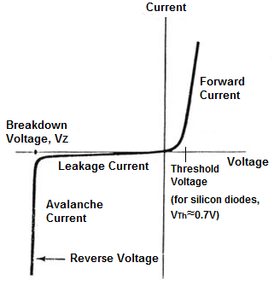
I-V characteristic of practical diode
(mA)
Diode symbol
P
N
V_{γ} is 0.6 ~ 0.7 Vfor Si
0.2 ~ 0.3 V for Ge
(μA)
I-V characteristic of Practical diode
Notes:
I-V characteristics:
I-V characteristics of the practical diode. The forward current is in the range of milli amperes when forward biased. When the diode is reverse biased only reverse saturation current flows which is in the range of few micro amperes.

Slide 16
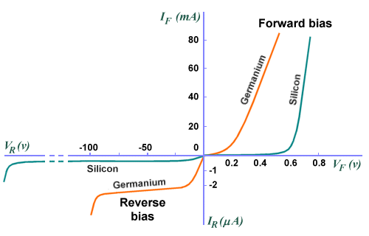
Silicon vs. Germanium
I-V characteristic of silicon and germanium practical diode
http://www.technologyuk.net/physics/electrical_principles/the_diode.shtml

Slide 17
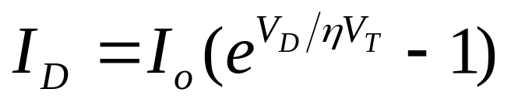
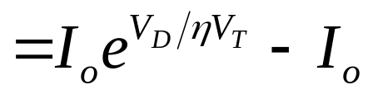
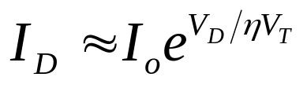
Diode current equation
I_{D} is diode current
I_{o} is reverse saturation current
V_{D} is voltage across diode
V_{T} is thermal voltage = T / 11600
η is a constant = 1 for Ge and 2 for Si
For positive values of V_{D} (forward bias),
For large negative values of V_{D} (reverse bias), I_{D} ≈ –I_{o}

Slide 18
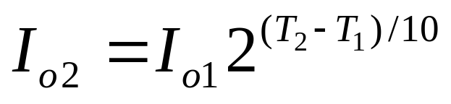
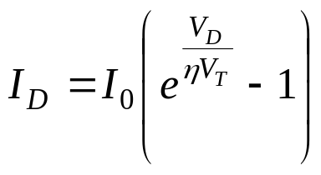
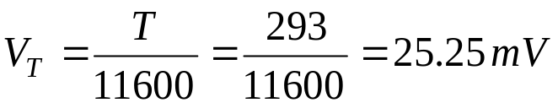
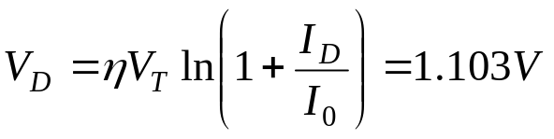
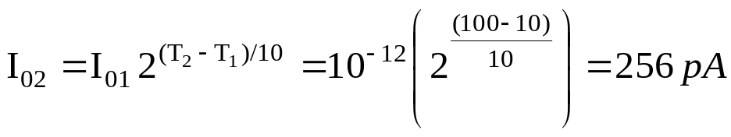
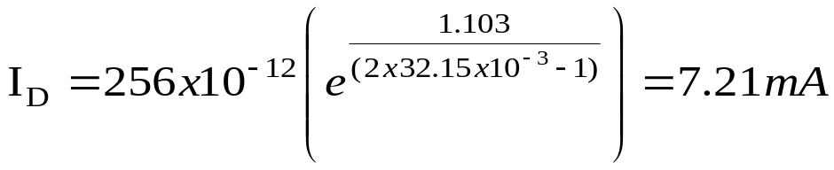
Effect of Temperature on the Reverse current
Reverse current doubles for every 10 degree rise in temperature.
Q. A Silicon diode has a saturation current of 1pA at 20⁰C. Determine (a) Diode bias voltage when diode current is 3mA (b) Diode bias current when the temperature changes to 100⁰C, for the same bias voltage.
A.
Notes:
Effect of Temperature on the Reverse current:
-Cut-in voltage decreases with increase in temperature
I_{o1} is the reverse saturation current at temperature T₁. If the temperature varies to T_{2,} then I₀₂ reverse saturation current at temperature T₂
doubles for every 10 degree rise in temperature.

Slide 19
Effect of Temperature on the Reverse current
I (mA)
–75ºC
125ºC
25ºC
V (volts)
I (μA)
19

Slide 20
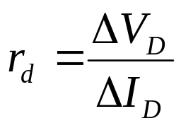
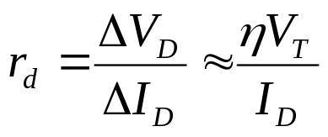
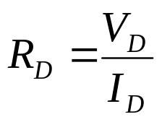
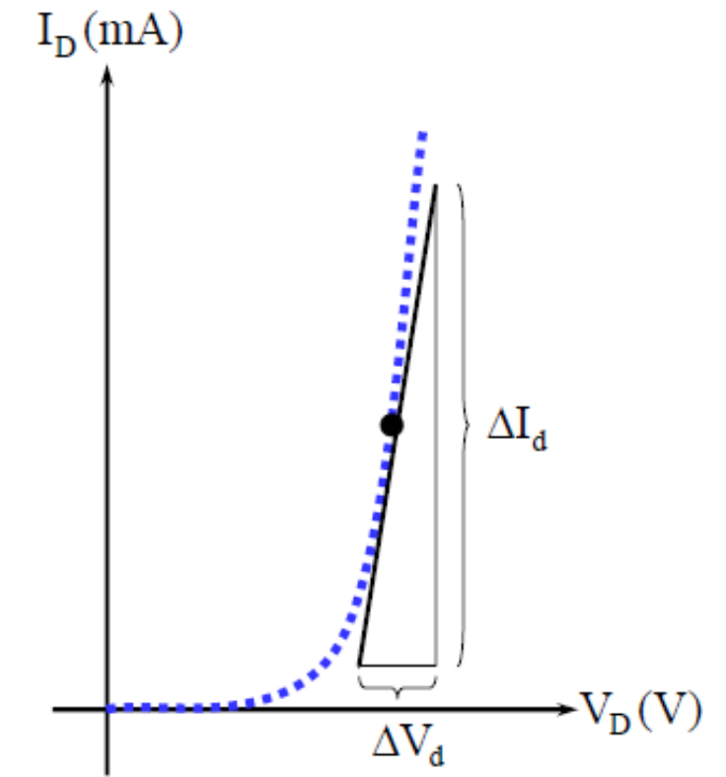
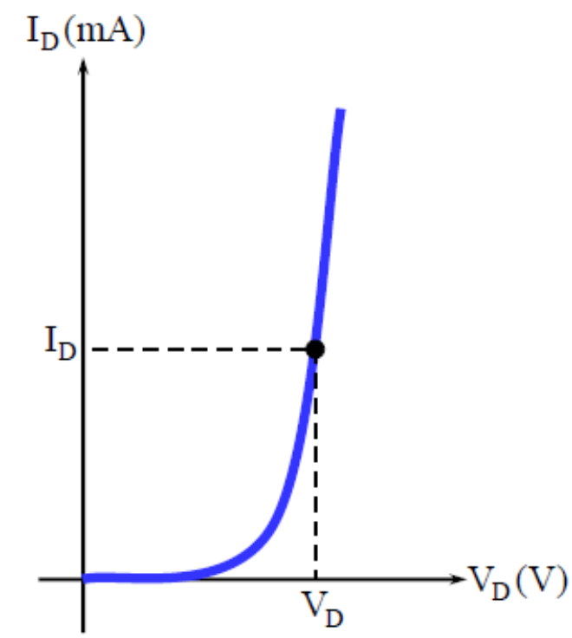
Diode resistances
Static or DC resistance:
  ratio of diode voltage and diode current
AC resistance:
Notes:
DC resistance:
-The dc resistance at the knee and below will be greater than the resistance at the linear section of characteristics.
-The dc resistance in the reverse bias region will naturally be quite high.
Dynamic or AC resistance
-Often sinusoidal voltages are applied to diode
-So the instantaneous operating point moves up and down in the characteristic curve
-So DC resistance is not a suitable parameter
-Instead, AC resistance is used
-It is the change in the diode voltage divided by the corresponding change in the diode current, where the change is as small as possible.
-Dynamic resistance can be found using previous equation, no need of characteristic curve
-Dynamic resistance in reverse region is very high, since slope of characteristic curve is almost zero
-The resistance calculated using equation does not include the resistance due to the metal contact (usually less than 0.1 Ω).

Slide 21
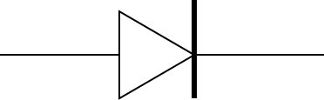

Diode Equivalent Circuit
Used during circuit analysis
Characteristic curve replaced by straight-line segments
A
K
1/R_{F}
A
K
Forward bias
R_{F}
R_{R} = ∞
Vγ
A
K
Reverse bias
Vγ

Slide 22
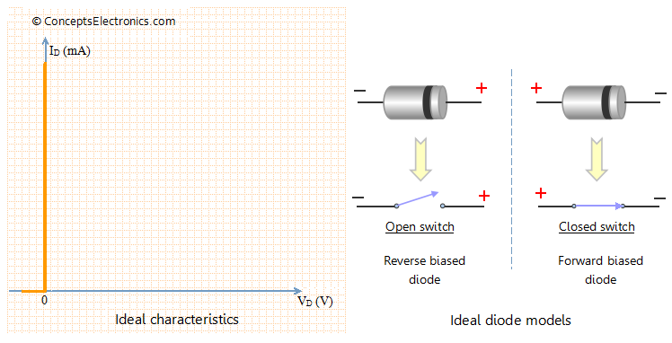
Ideal diode : I-V characteristics
I-V characteristic of Ideal diode and ideal models
[http://conceptselectronics.com/diodes/diode-equivalent-models/].
Notes:
Ideal Diode:
An ideal diode is simply a pn junction where the change from p-type to n-type material is assumed to occur instantaneously, also referred to as an abrupt junction. The simplified diode model ignores the effect of diode resistance in comparison with values of other elements of the circuit. The voltage drop across the diode (0.7 V for Si) is negligible. Hence the diode voltage drop can be ignored for simplification purpose.

Slide 23
Diode Equivalent Circuit
As further approximation, we can neglect the slope of the characteristic i.e., R_{F} = 0
A
K
R_{F} = 0
A
K
Forward bias
R_{R} = ∞
Vγ
A
K
Reverse bias
Vγ

Slide 24
Diode Equivalent Circuit
As third approximation, even the cut-in voltage can be neglected (Ideal diode)
A
K
R_{F} = 0
A
K
Forward bias
R_{R} = ∞
Vγ = 0
A
K
Reverse bias

Slide 25
Self test
1. The break-point voltage of Si diode is
a. 0.2V b. 0.7V c. 0.8V d. 1.0V
2. Why would you use silicon diodes instead of germanium diodes?

Slide 26
Breakdown phenomenon in diodes
Two breakdown mechanisms:
  Avalanche breakdown :
  Occurs in Lightly doped diodes,
  Occurs at high reverse Voltage.
  Zener Breakdown:
  Occurs in heavily doped diodes.
  at lower reverse bias voltages.
Notes:
Break down phenomenon in diodes:
Breakdown voltage is a parameter of a diode that defines the largest reverse voltage that can be applied without causing an exponential increase in the current in the diode. As long as the current is limited, exceeding the breakdown voltage of a diode does no harm to the diode.
Zener breakdown can be reversible (zener breakdown) and irreversible (avalanche breakdown) .
There are two breakdown mechanisms exist in diode.They are
-Zener breakdown
-Avalanche breakdown

Slide 27
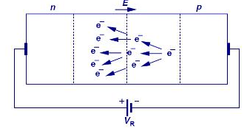
Avalanche Breakdown
Schematic of Avalanche phenomenon
http://shrdocs.com/presentations/12656/index.html
Notes:
Avalanche breakdown occurs when the applied voltage is so large that electrons that are pulled from their covalent bonds are accelerated to great velocities. These electrons collide with the silicon atoms and knock off more electrons. These electrons are then also accelerated and subsequently collide with other atoms. Each collision produces more electrons which leads to more collisions .The current in the semiconductor rapidly increases and the material can quickly be destroyed.Avalanche breakdown is observed for reverse bias voltages above 6V.

Slide 28
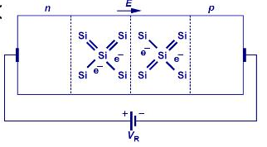
Zener Breakdown
Schematic of Zener phenomenon
http://shrdocs.com/presentations/12656/index.html
Notes:
In Zener breakdown the electrostatic attraction between the negative electrons and a large positive voltage is so great that it pulls electrons out of their covalent bonds and away from their parent atoms. Electrons are transferred from the valence to the conduction band. In this situation, the current can still be limited by the limited number of free electrons produced by the applied voltage so it is possible to cause Zener breakdown without damaging the semiconductor.This breakdown is observed for reverse bias voltages below 4V.

Slide 29
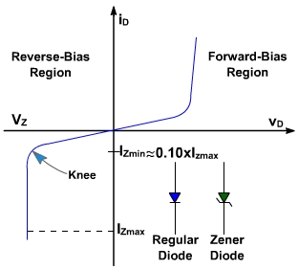
Zener Diode and its characteristics
P
P
N
N
Anode
Cathode
I_{ZK} or I_{Zmin}
I_{ZM} or I_{ZMax}
P_{ZM} or P_{ZMax}
P_{ZM} = V_{Z}.I_{ZM}
I-V characteristics of Zener diode
Notes:
Zener diode:
Zener diode (also referred as regulated diode) is a two terminal device that is widely used in voltage regulators. When the reverse bias, applied to the semiconductor, has reached to zener voltage Vz , the current will be dramatically increased while the voltage keeps constant.
I_{ZK} or I_{Zmin} – Minimum current necessary to maintain breakdown
I_{ZM} or I_{ZMax} – Maximum current that can be safely passed through the zener diode
P_{ZM} or P_{ZMax} – Maximum power dissipation across zener diode
P_{ZM} = V_{Z}.I_{ZM}
Zener diode is always connected such that it is reverse biased, and it is in zener breakdown region

Slide 30
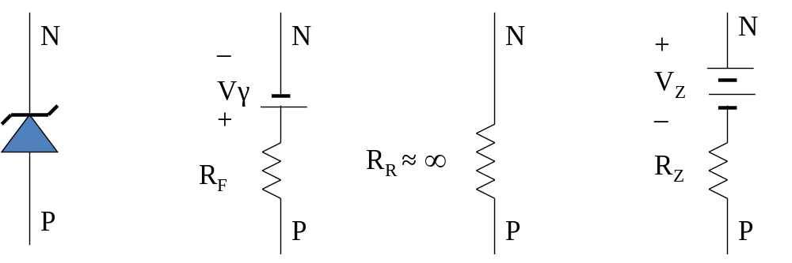
Equivalent circuit
Equivalent circuits of Zener diode
Forward Reverse Breakdown
Note: R_{Z} is usually very small, can be neglected

Slide 31
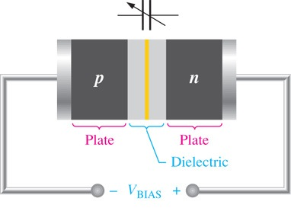
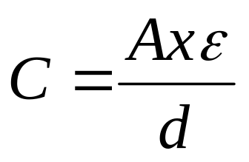
Diode as capacitor- Varactor diode
Notes:
Capacitance is determined by the parameters of plate area (A), dielectric constant (ε) , and plate separation (d), as expressed by the formula:
C= Aξ/d
As the reverse-bias voltage increases the depletion region widens, effectively increasing the plate separation, thus decreasing the capacitance.

Slide 32
Self test
  1. Explain the principle of PIN diode.
  2.What is the difference between PN diode and Schottky diode.
  3.Which type of diode exhibits negative resistance and why?
  4. Which of the following is not an essential element of a dc power supply
  a. Rectifier
  b. Filter
  c. Voltage regulator
  d. Voltage amplifier

Slide 33
Self test
  5. What is true about the breakdown voltage in a Zener diode?
  a. It decreases when current increases.
  b. It destroys the diode.
  c. It equals the current times the resistance.
  d. It is approximately constant
  6. Which of these is the best description of a Zener diode?
  a. It is a rectifier diode.
  b. It is a constant voltage device.
  c. It is a constant current device.
  d. It works in the forward region.

Slide 34
Exercises
1. Calculate the dynamic forward and reverse resistance of a P - N junction diode, when the applied voltage is 0.25V for Germanium Diode. I0 = lμA and T = 300 K. (Ans:rf=1.734 Ω; rr=390 MΩ)
2. A germanium diode has reverse saturation current of 0.19μA. Assuming η =1, find the current in the diode when it is forward biased with 0.3 V at 27ºC. (Ans: 19.5mA)
3. The forward current in a Si diode is 15 mA at 27ºC. If reverse saturation current is 0.24nA, what is the forward bias voltage? (Ans: 0.93V)
4. A germanium diode carries a current of 10mA when it is forward biased with 0.2V at 27ºC. (a) Find reverse sat current. (b) Find the bias voltage required to get a current of 100mA. (Ans: 4.42μA, 0.259V)

